Slide 1
Shell Bootcamp 2024 3 Reflections for Week 1
Sahithi Gonuguntla
Date : 30-Aug-2024

Slide 2
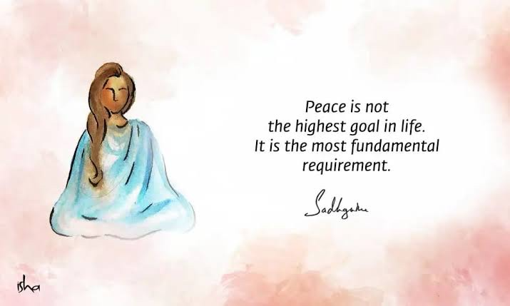
About Me
"Live with purpose, learn endlessly,
and inspire with passion."
Please share an image / visual that best represents you

Slide 3

My learnings from this week!

Slide 4
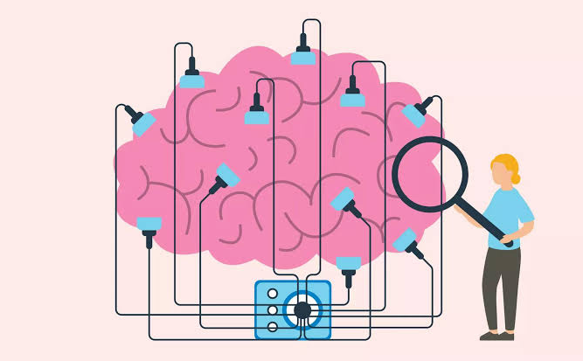
Learning 1 | My takeaways
Neuroplasticity
Neuroplasticity refers to brain’s ability to change and adapt in response to experiences and learning.
In energy sector, one can embrace neuroplasticity by continually learning and adapting to new technologies, regulations and market conditions.
[Add a graphic that provides evidence of what you learned]

Slide 5
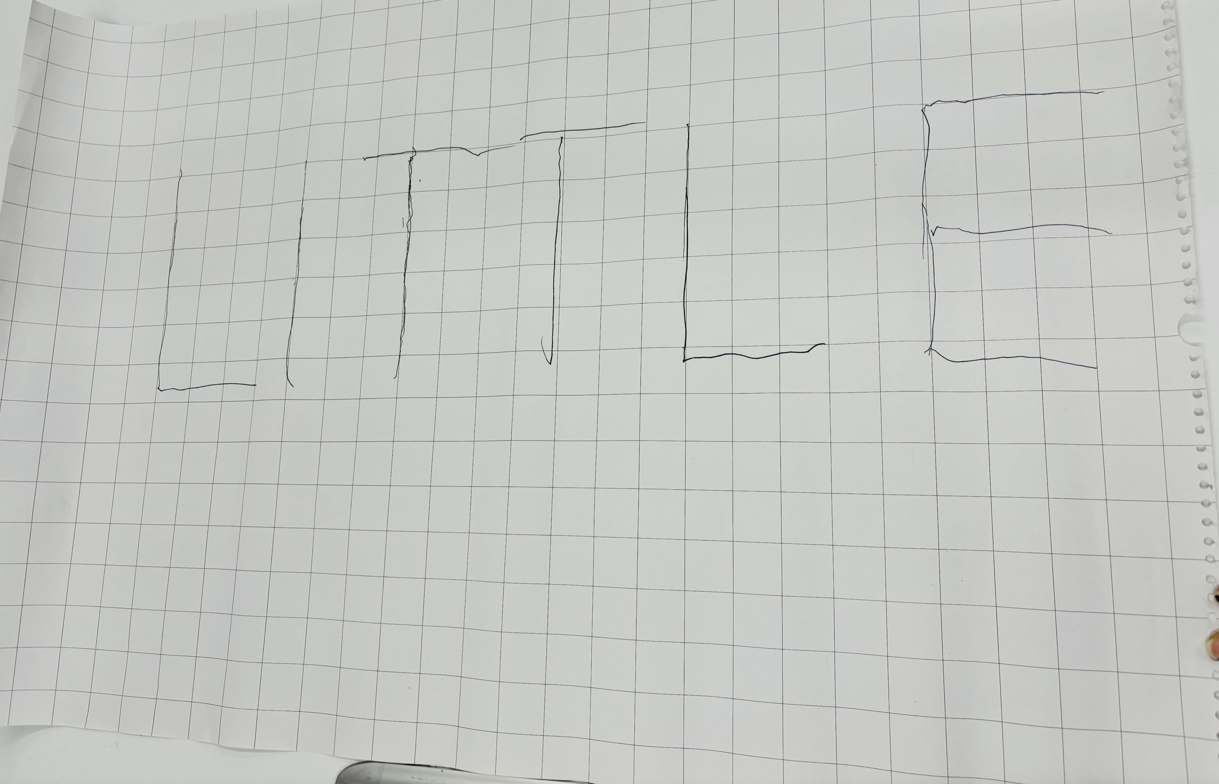
Learning 2 | My takeaways
Team work
Effective teamwork relies on clear communication, trust and a shared goal.
When team members collaborate openly and support each other, they can combine their strengths and skills to achieve better results than they could individually.
[Add a graphic that provides evidence of what you learned]

Slide 6
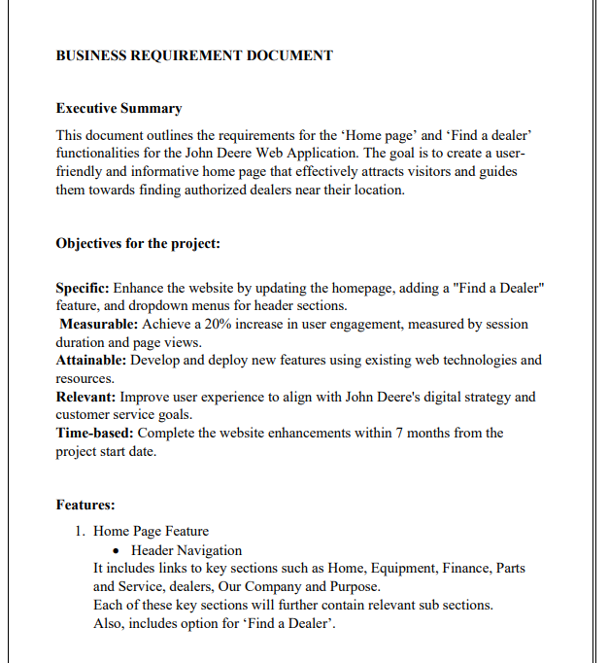
Learning 3 | My takeaways
Business Requirement Document
BRD serves as a blueprint that outlines what the business needs and expects from the project.
In the Energy sector, for example, if a company is planning to build a new LNG plant, the BRD would outline all business needs such as production capacity, timeline, budget and stakeholder expectations.

Slide 7

Relevance of learnings for my organization

Slide 8
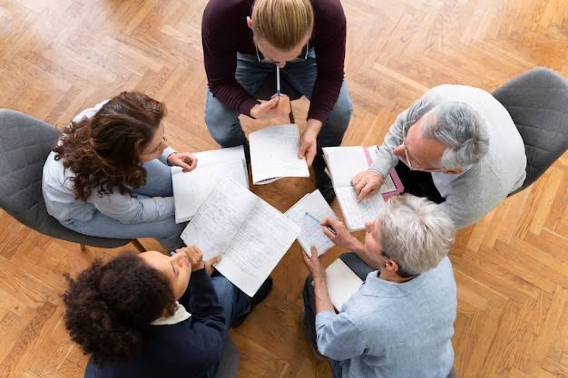
Learning 1 | Relevance for Shell
Neuroplasticity Shell offers workshops, training sessions and various learning by which I can learn continuously and adapt to new technologies.
By learning continuously, I can quickly adapt to new technologies and also improve my problem solving skills and can come up with innovative solutions and strategies
[Add a graphic that provides view of how Shell implements this learning]

Slide 9
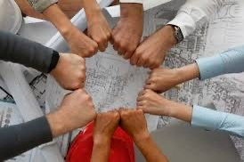
Learning 2 | Relevance for Shell
Team work
Regular team building exercises can strengthen relationships and improve cooperation among team members. Shell has no hierarchy rules, ensuring open communication and collaboration among the team members.
With better teamwork, tasks can be divided according to each member’s strengths, leading to more efficient workflows and high productivity.
[

Slide 10
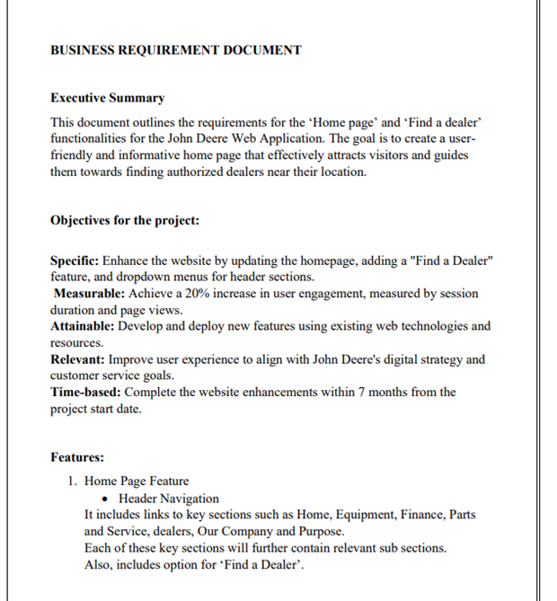
Learning 3 | Relevance for Shell
Business Requirement Document
BRD provide detailed outline of project ensuring that all stakeholders have a shared understanding of what needs to be achieved. It also helps in more accurate planning and resource allocation.
BRD serves as a reference point for discussions between stakeholders, reducing misunderstandings and miscommunications which can result in loss of project or resources.

Slide 11

Challenges in implementing learning

Slide 12
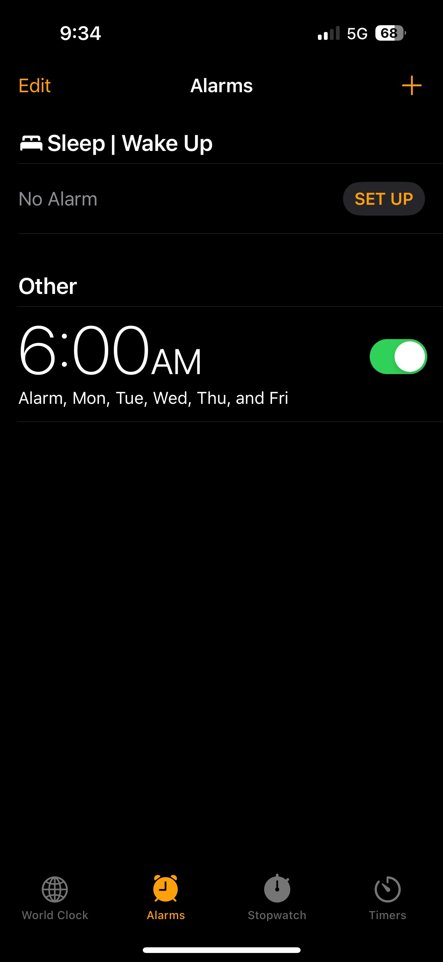
Challenge faced while implementing Learning 1
Neuroplaticity
To implement neuroplasticity, continuous learning is required. I tried of making a habit of waking up early at 5:30 AM. I could not wake up and used to turn off the alarm. It becomes even worse on weekends.
I am still working on this habit and I progressed from 7AM to 6AM.

Slide 13
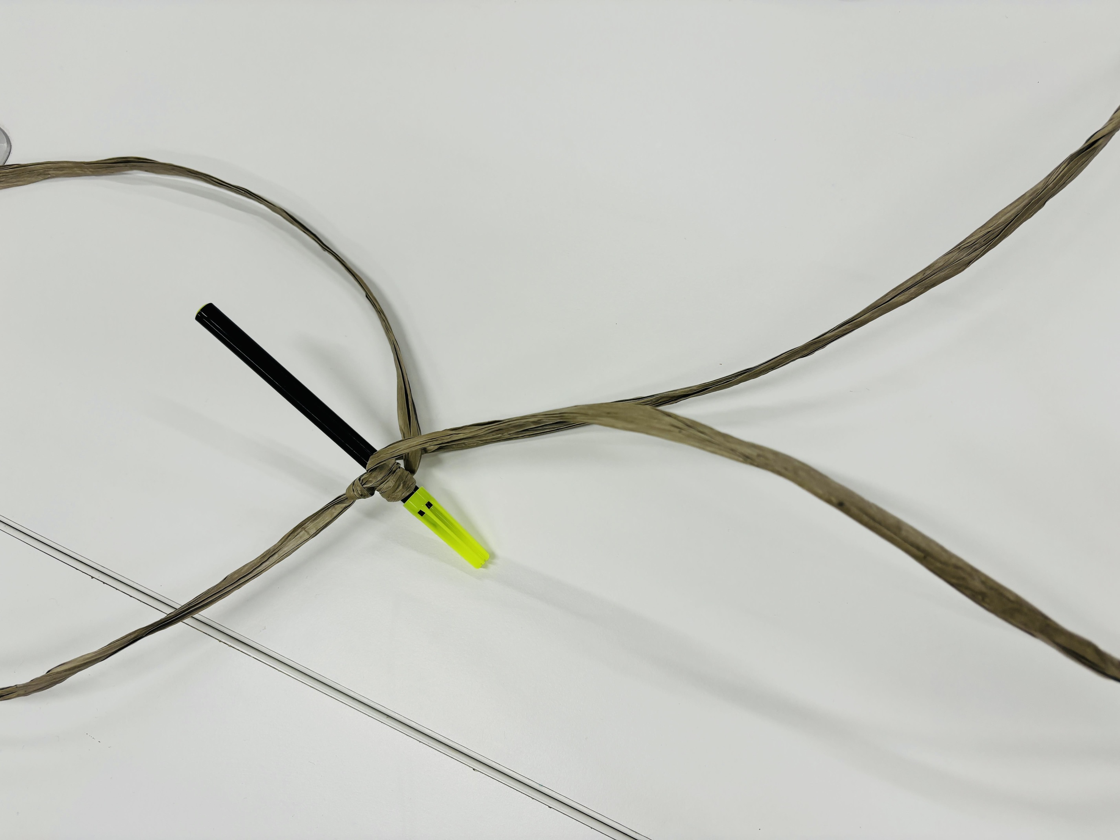
Challenge faced while implementing Learning 2
Team work
On the three days soft skill sessions, me and my team has done many activities. I am a bit introverted and afraid to be in larger groups. At first, I felt really uncomfortable but when I started working with my team I found myself contributing a lot which increased my confidence and self- awareness.
[Add a graphic that provides evidence of what you did to overcome this challenge]

Slide 14
Challenge faced while implementing Learning 3
BRD
The whole business analyst topic is very new to me. Since all these terms are new I faced some difficulties while working on BRD. Sohail sir then clearly explained what are the changes that can be made on the document which made the topic easier.

Slide 15

Action Plan

Slide 16
My Action Plan for this Week
Actions
Timeline
Status
Learn business etiquettes, practice growth mindset and self-discipline.
26-08-2024
to
09-09-2024
Learned mobile etiquettes, E-mail etiquettes and waking up early.

Slide 17

Learning is also Fun!

Slide 18
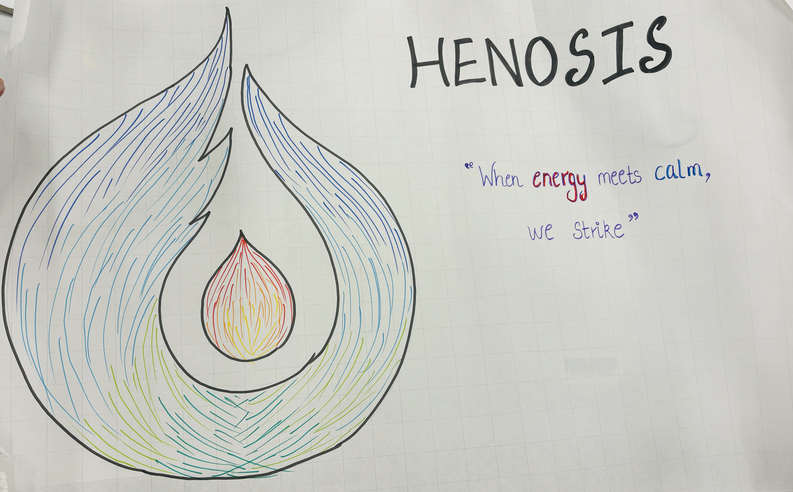
Learning is also Fun!
Our instructor assigned a fun activity that is to make a logo with a name and a tagline that represents our team.
We had fun while doing this activity and I came up with the tagline for our group which is quite catchy.

Slide 19

Summary
Soft skills really helped in understanding teamwork, adaptability, emotional intelligence, conflict resolution and time management
In upcoming week, we have foundational bootcamp on technical topics like DBMS, agile, system testing, DevOps and cloud.
In current week, we learned business analysis which in turn connected to the topics that will be covering in the next week.

Slide 20
Thank You

